Slide 1
Organization and Management
Presenters:
Ajay Maharjan (06)
Ashish Rai (42)
Nibendra Bajracharya (15)
Sujan Maharjan (37)

Slide 2
1.5 Organization Structure

Slide 3
Line Organization
Oldest and traditional form
Direct line of authority from the superior to subordinate level.
Also known as simple and military organization
Follows the chain of command and scalar chain
Types of Line Organization
Pure line Organization: individuals perform same type of work Line is divided into effective control and supervision
Department line Organization: Organization is divided into different departments.

Slide 4
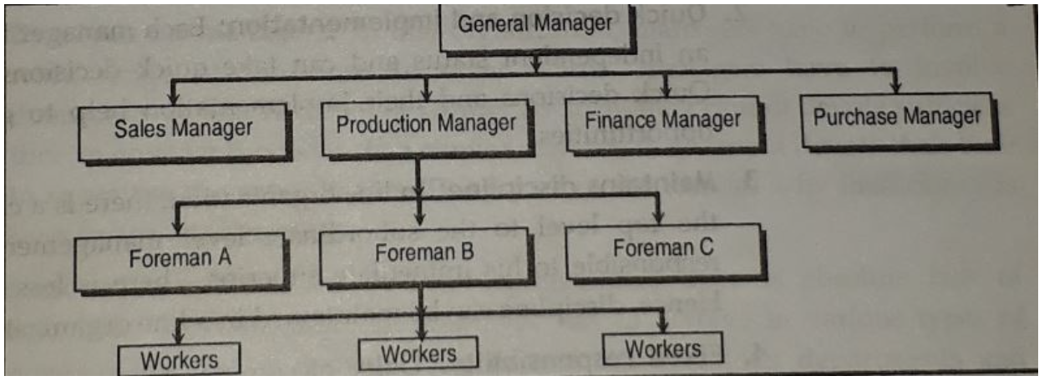

Slide 5
Advantages
Simple and Easy To understand
Quick Decision And Implementation
Maintain Discipline
Fixed Responsibility
Flexibility
Effective Management
Economical

Slide 6
Disadvantages
Overload on Managers
Lack of specialization
Autocratic Leadership
Problems of coordination
Inefficiency
Lack of stability
https://tyonote.com/line_organization/

Slide 7
Functional Organization
Divides entire functions into major functional groups
Each function is entrusted to a specialist-functional specialist
Functional manger can exercise functional authority to overall subordinates
Functional specialist communicate through chief executive

Slide 8
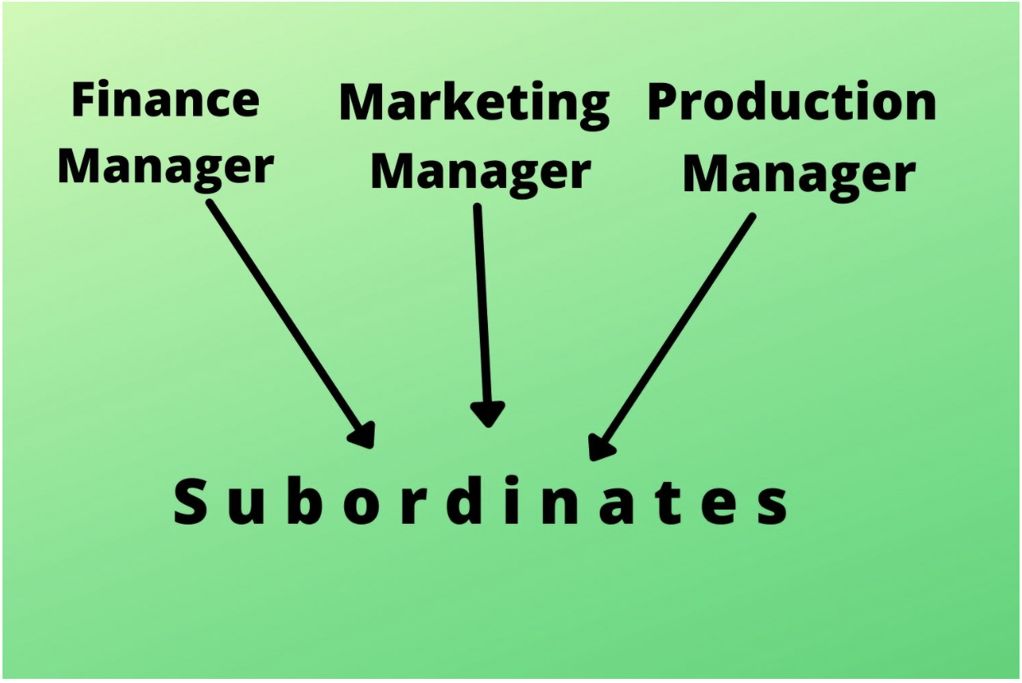

Slide 9
Advantages
Benefits of Specialists
Increase Efficiency
Healthy Competition Among Experts
Relief To Executives
Mass Production
Facilitates Growth and Expansion

Slide 10
Disadvantages
Multiple Command System
Lack of Coordination
High Administrative Cost
Delay in Decision-Making
Spoils Human Relations
Narrow Outlooks of Specialists

Slide 11
Line and Staff Organization
Line-staff organization, in management, approach in which authorities (e.g., managers) establish goals and directives that are then fulfilled by staff and other workers.
Line groups are engaged in tasks that constitute the technical core of the firm or the subunit of a larger enterprise.
Staff groups are engaged in tasks that provide support for line groups. They consist of advisory (legal), service (human resources), or control (accounting) groups.
The staff are thinkers while the line are doers.

Slide 12
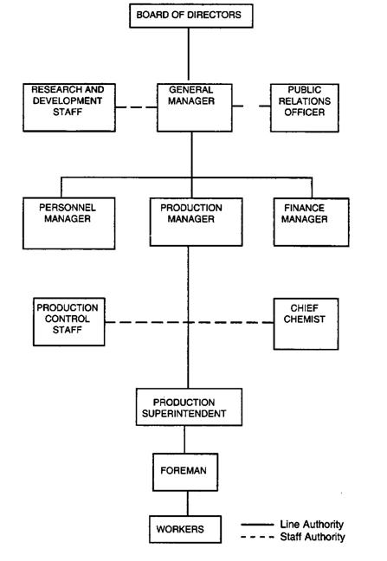

Slide 13
Advantages
Expert advice
Benefit of Specialization
Better co-ordination
Balanced decisions
Improved quality
Well defined authority and responsibility
Less wastage

Slide 14
Disadvantages
Chances of mis-interpretation
Ineffective staff in the absence of authority
Line and staff conflicts
Staffs steals the show
Costly
Lack of sound advice

Slide 15
Committee Organization
A committee organization is an association of people set up to arrive at solutions to common problems.
Committee organizational structure provides integrated ideas of various related people of the company.
It is a very good example of democratic management wherein every member has an equal opportunity to raise his voice and come to a common solution.
A committee may be of two types:
Executive Committee (Permanent Committee)
It is formed when the nature of the work is of repetitive type.
Advisory Committee (Ad Hoc Committee)
It is formed temporarily for some specific temporary function only.

Slide 16
Advantages
Quality of decision
Participative management
Reduce Bias and Conflicts
Setting Objectives, Plans and Policies
Co-ordination
Promotes united actions

Slide 17
Disadvantages
Delay in decision
Probability of diversion
Lack of Secrecy
Costly
Compromise

Slide 18
1.6 Purchasing and Marketing Management

Slide 19
Purchasing
First phase of Materials Management
Buying or acquiring goods and services to make supply chain management more efficient
Operation of market exploration to procure goods and services of desired quality, quantity at lowest price and at the desired time
Includes research and development for the proper selection of materials and sources, follow-up to ensure timely delivery, inspection to ensure both quantity and quality

Slide 20
Purchasing Department
Responsible for procuring the goods, raw material & services required to operate the organization effectively
Every organization has its specific needs when it comes to the sourcing and procurement of equipment, raw materials, and services

Slide 21
Key Functions of Purchasing Departments
Identify business requirements for goods, materials, and services
Find reliable suppliers to meet these requirements
Negotiate prices, build quality, and delivery terms
Set up the order quantities and making bid requests on supply contracts
Coordinate delivery and storage operations
Run quality control and product testing

Slide 22
Duties and Responsibilities of Purchasing Departments
Maintaining long-term exclusive partnerships with top vendors
Acquiring goods at competitive rates
Researching goods and products carefully based on quality, prices, and delivery terms
Creating transparency in delivery and order processes
Building conclusive financial reports to calculate ROIs

Slide 23
Purchasing Methods
1. Purchasing by Requirement
Purchasing goods only when needed and in required quantity
Goods which are not regularly required i.e. emergency goods
2. Market Purchasing
Buying goods for taking advantages of favorable market situations
Purchases are not made to meet immediate needs but are acquired as per the future requirements

Slide 24
3. Speculative Purchasing
Purchasing at lower prices with a view to sell them at higher prices in future
Purchases are not made as per the production needs of the plant, but to earn profits out of price rises later on
4. Purchasing for Specific Future Period
Purchasing goods which are regularly required, in small quantity, and chances of price fluctuations are negligible
Needs for specific period are assessed and purchases made accordingly

Slide 25
5. Contract Purchasing
Specific quantity of materials is contracted to be purchased and delivery is taken in future
Price and other terms and conditions are fixed at the time of contract
6. Scheduled Purchasing
Suppliers are supplied a probable time schedule for material requirements
Suppliers are informed of probable needs and orders are sent accordingly; not a contract

Slide 26
7. Group Purchasing of Small Items
For purchasing a number of small items such that the costs of placing orders may be higher than prices of the items
Buyer places order with a vendor for those items; vendor takes a certain percentage of profit
8. Co-operative Purchasing
Small industrial units may join to pool their requirements and then place bulk orders with dealers
Obtain rebates on large quantity purchases, cash discounts and savings in transportation costs

Slide 27
Marketing
According to American Marketing Association (AMA), marketing is defined as "the activity, set of institutions, and processes for creating, communicating, delivering, and exchanging offerings that have value for customers, clients, partners, and society at large".
Four P's of Marketing:
Product
Pricing
Placement
Promotion
Marketing Management
Performs all management function related to the field of management.
Performs activities to determine the needs of customer.

Slide 28
Marketing Concept
Use of marketing data to focus on the needs and wants of customer
Three fundamental beliefs:
Customer oriented
Profit oriented
Satisfaction of customers
Market Research
Systematic gathering, recording and analysis of qualitative and quantitative data
Four key element to market research
Analysis of current activities
Market intelligence
Market analysis
Product Evaluation

Slide 29
Function of Marketing
Pricing
Based on the quality and demand the price is set for the product
Buying
Involves where to buy, what to buy, how much, from whom, when and at what price
Distribution
Determine the best way for a customer to locate, obtain and use the product and service of organization.
Markets information management
Strategic marketing is driven by data so an organization need to gather information about the customer rivals and market trends for an organization to success.
Promotion
Financing

Slide 30
Advertisement
Forms of marketing used to encourage the customer and end user to take action upon product.
Medium: newspaper, online sources, etc.
Increase awareness to the people about the product

Slide 31
THANK YOU

